Slide 1
Infrastructure
By
Sneha Venkatesh

Slide 2
Infrastructure
Physical Hardware used to interconnect computers and users.
Everything that supports the flow and processing of information.
Internet
WiFi
WiMAX
MiFi

Slide 3
Intelligence
Computation
Connectivity

Slide 4
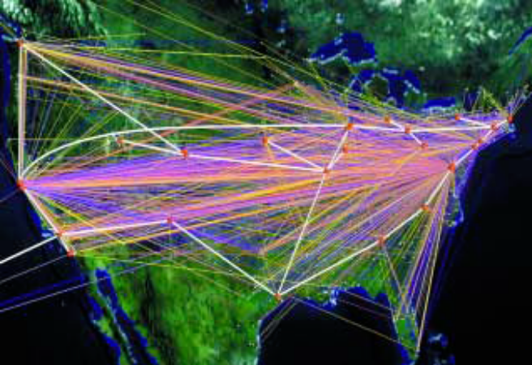
Internet
The Internet - 11
Global system of interconnected computer networks that use the
standard Internet Protocol Suite (TCP/IP) to serve billions of users worldwide
Why do people worldwide use the Internet?
To communicate and socialize [Facebook, MySpace, Orkut]
To find information, learn new things and be entertained
To run a business [e-commerce, e-Learning]

Slide 5
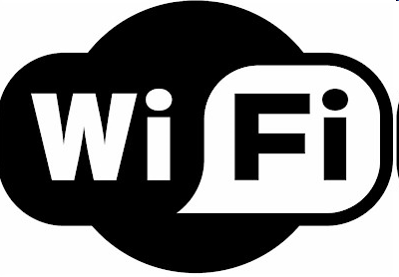
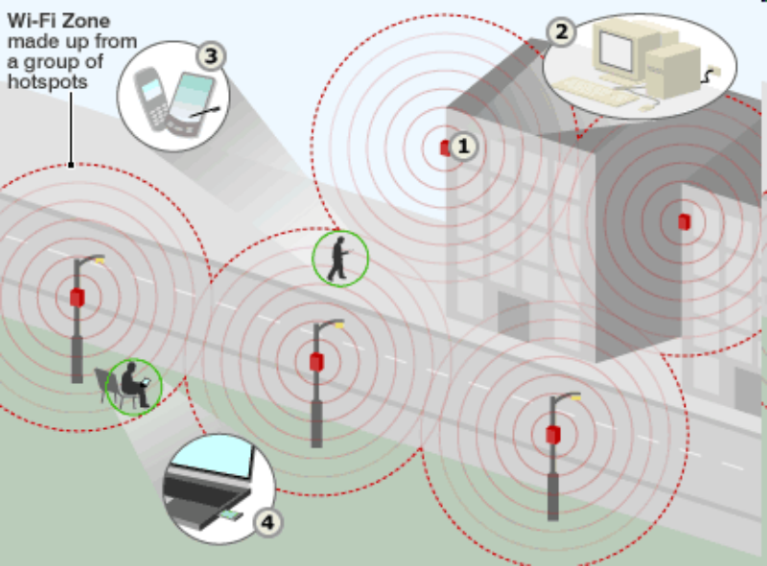
Wi-Fi is the acronym for Wireless Fidelity, essentially a set of standards for transmitting data over a wireless network.
Uses radio frequency to transmit data through the air.
One wireless router can allow multiple devices to connect to the Internet.
Wi-Fi zone made up from a group of hotspots

Slide 6
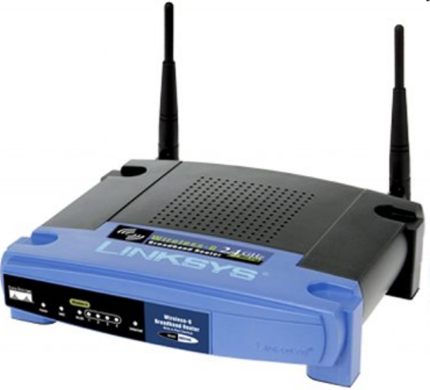
Wi-Fi
A wireless router uses an antenna to send signals to wireless devices and a wire to send signals to the Internet.
Wi-Fi radios have notable differences with other radios
They transmit at frequencies of 2.4 GHz or 5 GHz
They use 802.11 networking standards, which come in several flavors
Wireless router

Slide 7
802.11a
Transmits at 5 GHz and can move up to 54 megabits of data per second.
Uses orthogonal frequency-division multiplexing (OFDM)
802.11b
It is the slowest and least expensive standard.
It transmits at 2.4 GHz frequency.
It can handle up to 11 megabits of data per second
It uses complementary code keying (CCK) modulation to improve speeds.
802.11g
It transmits at 2.4 GHz like 802.11b
It can handle up to 54 megabits of data per second.
It is faster because it uses the same OFDM coding as 802.11a.
802.11n
The newest standard that is widely available.
Significantly improves speed and range.
Can achieve speeds as high as 140 megabits per second.

Slide 8
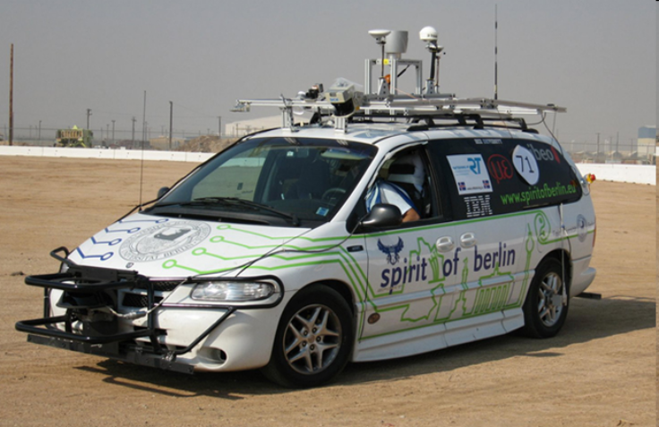
Driving a car using iPhone
The Spirit of Berlin team at Freie University Berlin has developed an iPhone app to remotely control car.
How it works
The iPhone connects to the driving circuitry by Wi-Fi network.
The car onboard circuitry offers three types of controls:
Steering wheel
Gas (Accelerator throttling)
Brakes

Slide 9
Think about how we access the Internet today
There are basically three different options:
Broadband access
Wi-Fi access
Dial-up access
What if there were a new technology that solved all of
these problems?
The high speed of broadband service
Wireless rather than wired access
Broad coverage like the cell phone network instead of small Wi-Fi hotspots

Slide 10

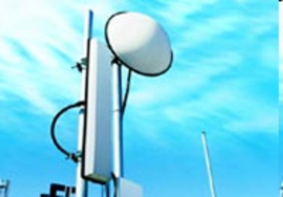
WiMAX is short for Worldwide Interoperability for Microwave Access, and it also goes by the IEEE name 802.16.
WiMAX would operate similar to Wi-Fi but at higher speeds, over greater distances and for a greater number of users.
A WiMAX system consists of two parts:
A WiMAX tower : A single WiMAX tower can provide a very large area as big as 3000 square miles.
A WiMAX receiver
WiMAX transmitting tower

Slide 11
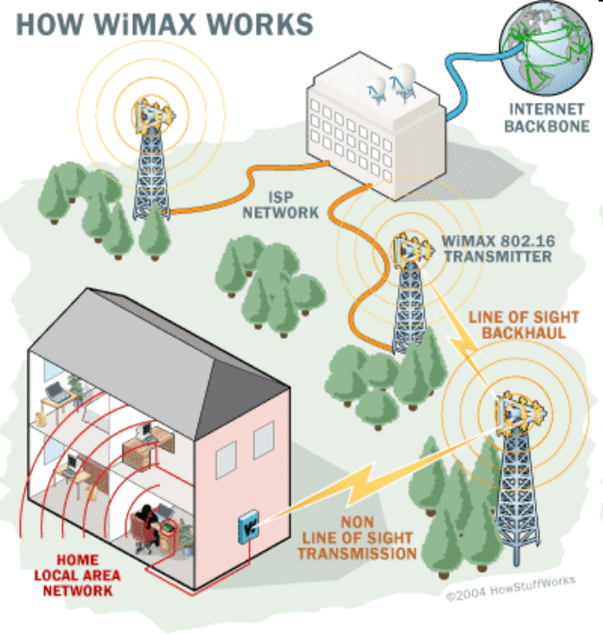
WiMAX
WiMAX can provide two forms of wireless service
Non-line-of-sight:
In this mode, WiMAX uses a lower frequency range 2 GHz to 11 GHz (similar to WiFi) and has the ability to bend around the obstacles more easily.
2) Line-of-sight:
This connection is stronger and more stable, so it is able to send a lot of data with fewer errors. It uses higher frequencies, with ranges reaching a possible of 66 GHz.

Slide 12
WiMAX vs WiFi
Speed: The fastest WiFi connection can transmit up to 54 megabits per second under optimal conditions. WiMAX should be able to handle up to 70 megabits per second.
Distance: WiFi's range is about 100 feet. WiMAX will blanket a radius of 30 miles with wireless access.
Cost: Instead of putting in a bunch of WiFi hot spots that cover a few hundred square yards, a city could pay for one WiMAX base station and cover an entire financial district.

Slide 13
WiMAX….
Disadvantages
Other wireless equipment could cause interference.
WiMAX is very power intensive technology and requires strong electrical support thus it is another turning point for mobile devices which heavily rely on batteries.

Slide 14

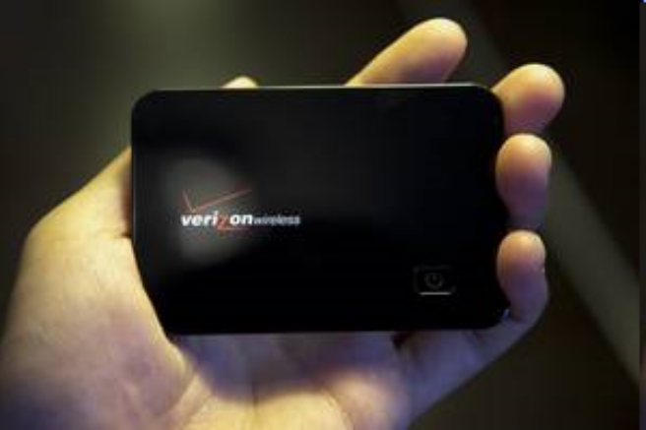
A small, portable wireless device which creates a personal cloud of high-speed Internet connectivity and delivers wireless 3G data network access to multiple users in a small area.
Size of eight stacked credit cards and weighs just over 2 ounces
The battery lasts for about four hours of use and 40 hours of standby on a charge, according to Verizon Wireless.
Creating portable Wi-Fi hotspots, the device can connect up to five Wi-Fi enabled devices to the Internet at any place, any time, up to a range of 10 meters.
Verizon Wireless MiFi 2200 Intelligent Mobile Hotspot

Slide 15
MiFi….
Advantages
Connection sharing
Cost savings
Portability
Fast set-up

Slide 16
Conclusion
Wi-Fi offers tremendous potential for network connectivity without the inconvenience of wires and cables.
WiMAX advantages exceed the performance and cost advantages that people talk about always.
WiMAX offers developing and poor areas wireless access without the need of proper infrastructure.
MiFi is new and interesting technology which is simple-to-use and allows up to five devices to access the 3G network at a time.
With all these emerging technologies, there is no doubt that in the near future everything will be fully automated.

Slide 17

Thank You

